Slide 1


Power BI Dashboard – Sales and Profit Analysis
A detailed view of sales performance trends, by year, region, category, and individual.
by Sakshi Khedekar

Slide 2
Dashboard Overview
Objective
Insights
Visualize Total Sales, Profit, Profit Ratio
Sub-Category Analysis
Analyze Performance by Year, Category, Region
Sales by Person
Market Return by Region

Slide 3
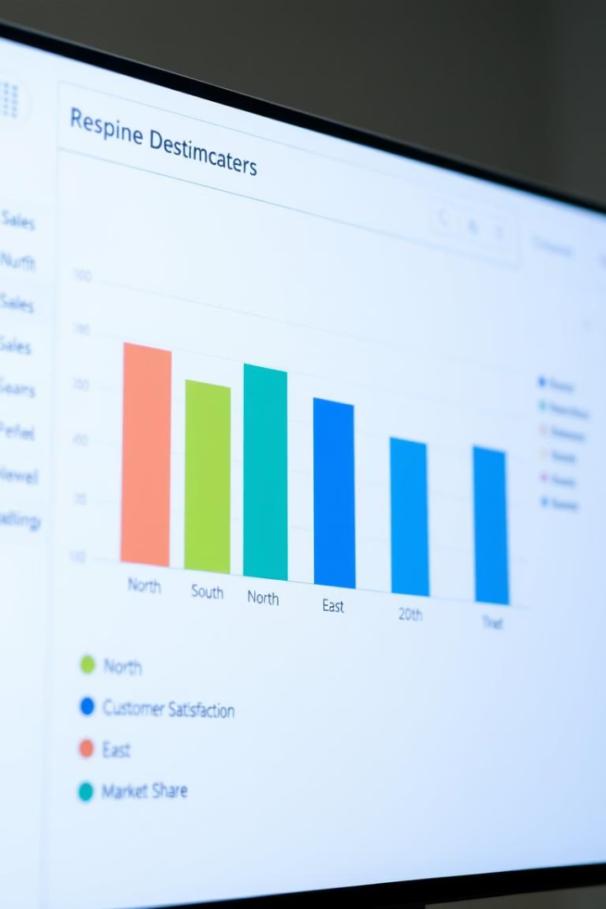



KPI Highlights
Total Sales
Total Profit
₹62.27M
₹1.51M
Profit Ratio
2.42%

Slide 4
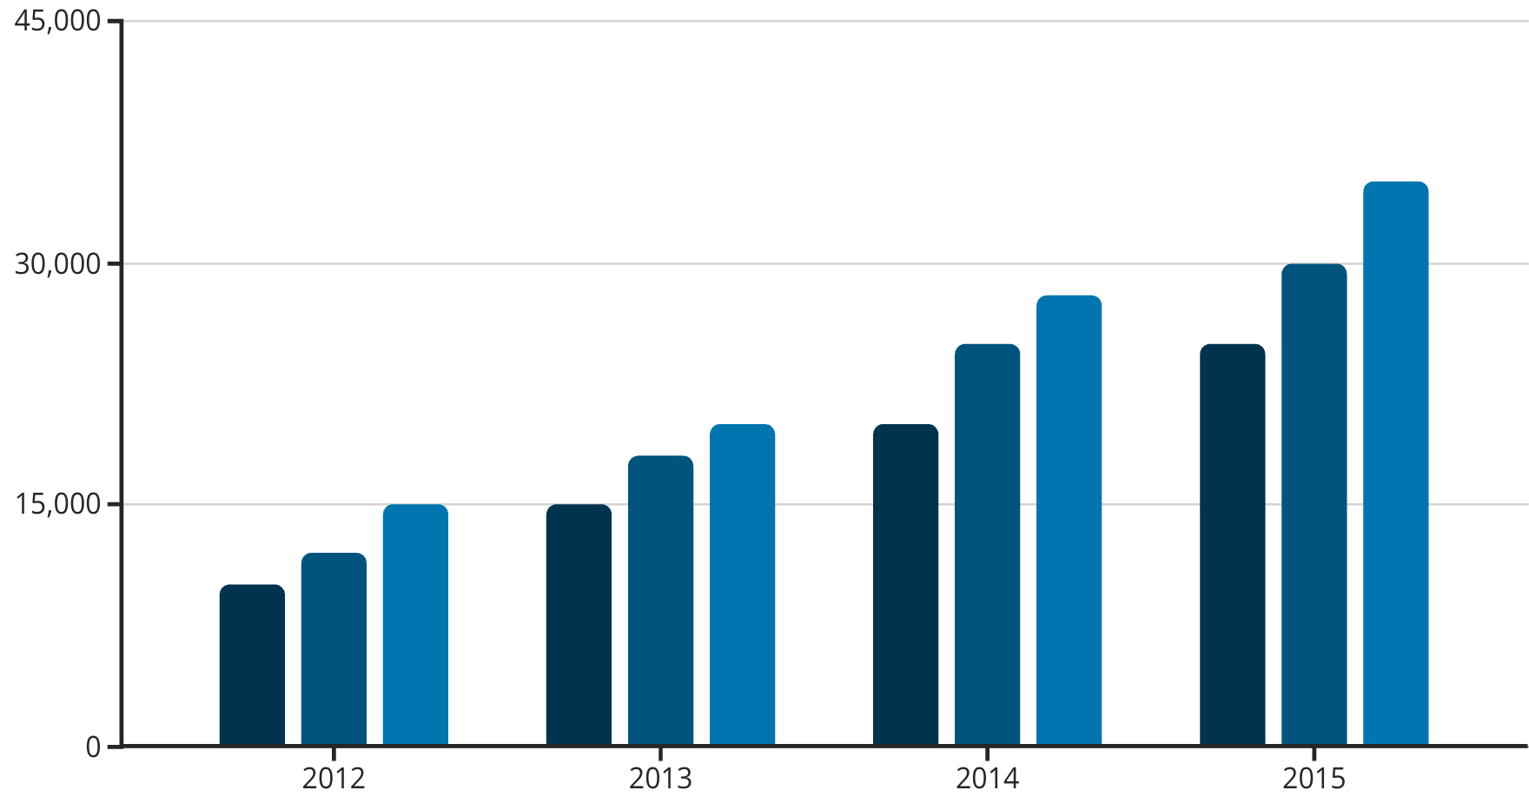
Sales by Year and Category
Furniture
Office Supplies
Technology

Slide 5


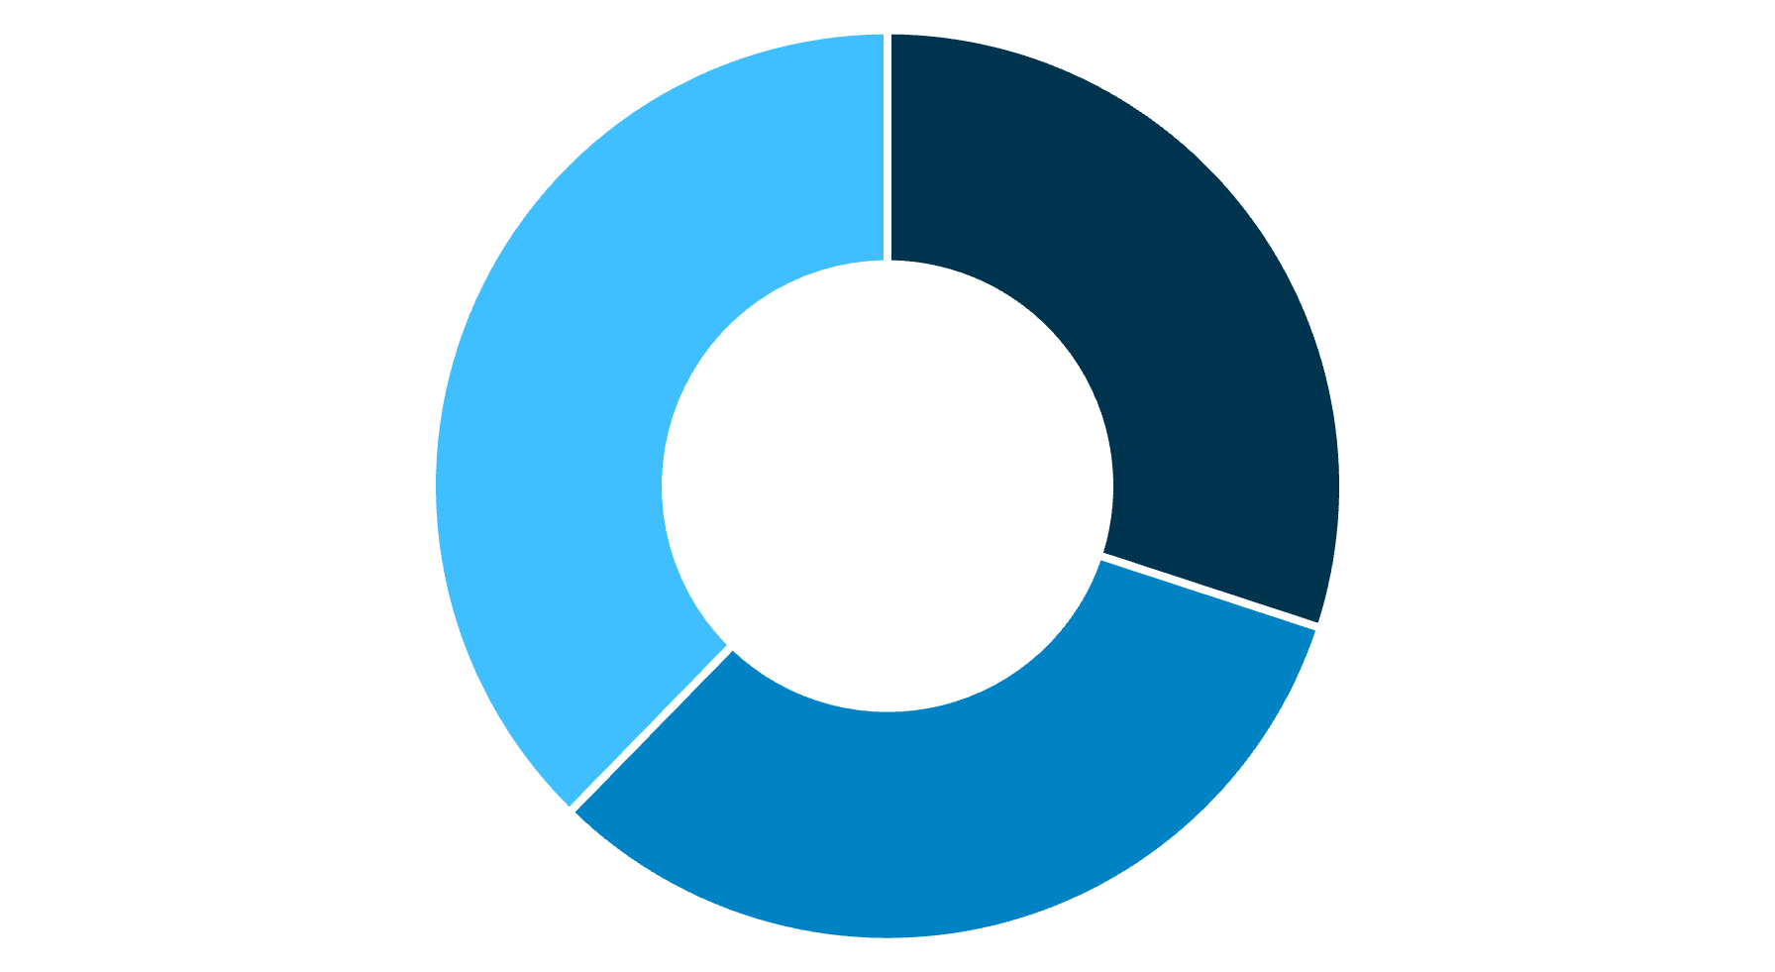
Region-wise Profit Ratio
Top Region
Lowest Region
Canada (7.51%)
Central Asia (-9.38%)
Sales by Category Donut Chart representation:
Technology
Furniture
Office Supplies

Slide 6
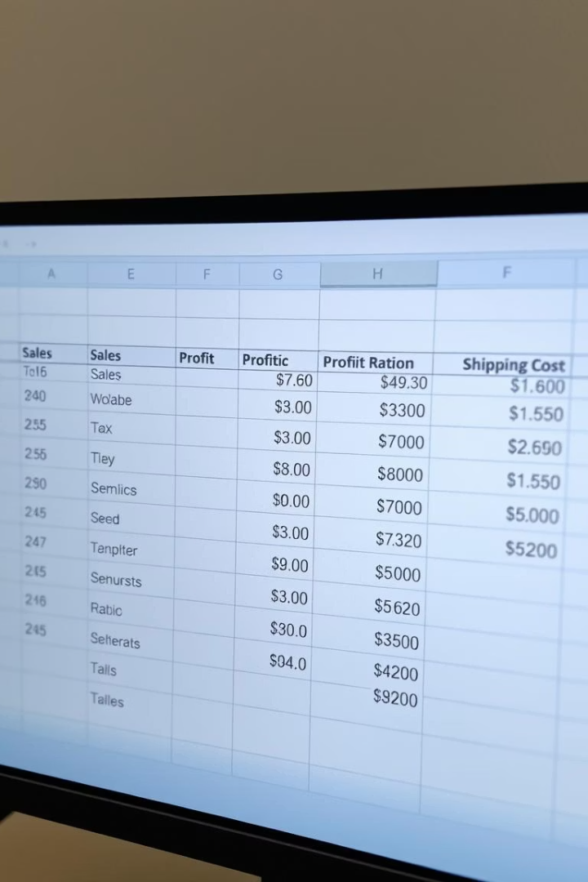
Sub-Category Analysis
Sub-Category
Sales
Profit
Profit Ratio
Shipping Cost
Accessories
₹38,05,275.44
-3.41%
₹83,592.33
Appliances
₹50,26,141.12
-2.82%
₹1,08,307.75
Art
₹18,22,214.31
-5.37%
₹41,889.08
Binders
₹22,88,962.65
-3.16%
₹49,773.10
Bookcases
₹70,61,788.56
-2.29%
₹1,55,487.97

Slide 7

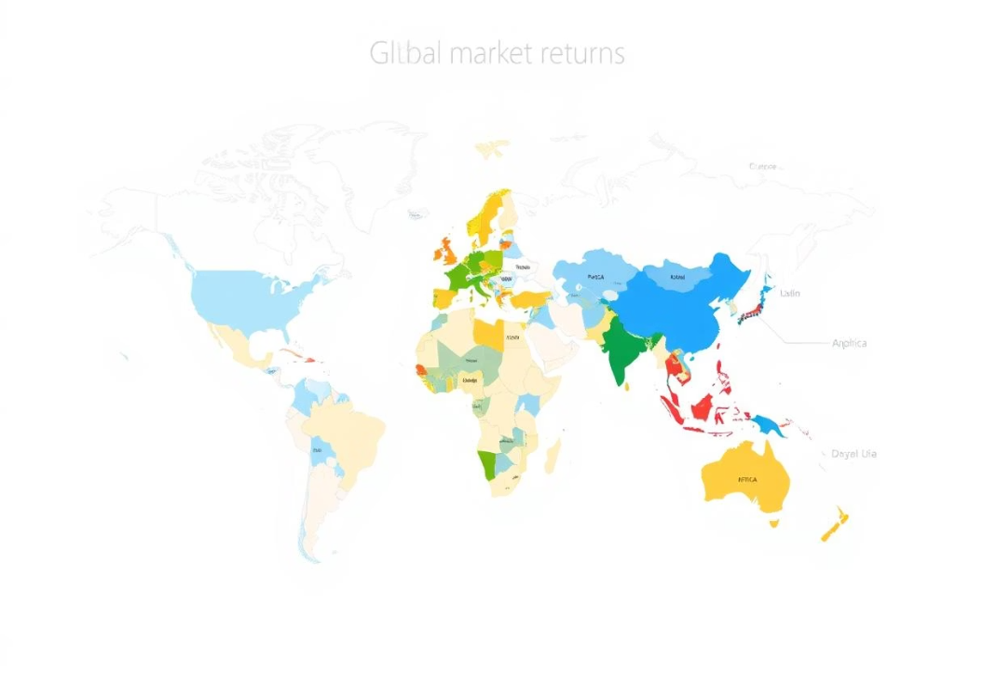
Sales by Person
Top Performers
Gilbert Wolff → ₹8.7M
Nicodemo Bautista → ₹6.1M
Kauri Anaru → ₹5.7M
Market Returned by Region

Slide 8



Conclusion
1
Summary of Insights
2
Key Takeaways
3
Business Recommendations

